Slide 1
Final Project Title
Delivering an ML/AI Strategy, AI for Business Leaders, Udacity
Asuka Ikemoto, May - 2025
© 2024 Udacity.

Slide 2
Executive Summary
Purpose of Project
Final project of an ML/AI strategy
Methodology
Analysis conducted over 2 days
Over 4 potential use cases underwent thorough assessment for feasibility and impact
Incorporated both technical knowledge and user feedback
Path Forward
1 use case identified for implementation
Needs and requirements to be successful
Next steps

Slide 3
I Began with Four Use Case Ideas
Use Case 1
Microscopic error-detection system
A system using computer vision to automatically identify product defects during the manufacturing process.
------------------------------------------
Use Case 4
Sales offices allocation tool
A tool that analyzes demographic and sales data to recommend optimal locations for opening or closing retail stores.
------------------------------------------
Use Case 2
Production optimizer
An AI-driven tool that forecasts demand and adjusts production schedules to minimize costs and maximize efficiency.
------------------------------------------
Use Case 3
Transfer pricing analyzer
A tool that supports compliance by analyzing intercompany pricing across regions to align with international tax regulations.
------------------------------------------

Slide 4
I Assessed Feasibility vs. Impact for All Cases
high
UC 1
UC 1
UC1: <Microscopic error-detection system>
UC 2
UC 2
UC2: <Production optimizer>
UC 4
UC3: <Transfer pricing analyzer>
UC 3
Impact
UC 3
UC 4
UC4: <Sales offices allocation tool>
low
low
Feasibility
high

Slide 5
Transforming Our Business Using ML/AI with These Top Two Use Cases
Microscopic error-detection system
A system using computer vision to automatically identify product defects during the manufacturing process.
Production optimizer
An AI-driven tool that forecasts demand and adjusts production schedules to minimize costs and maximize efficiency.
By executing on these two projects I believe we can drive operational excellence for our business by improving quality and aligning production with demand and become a data-driven manufacturing business.

Slide 6
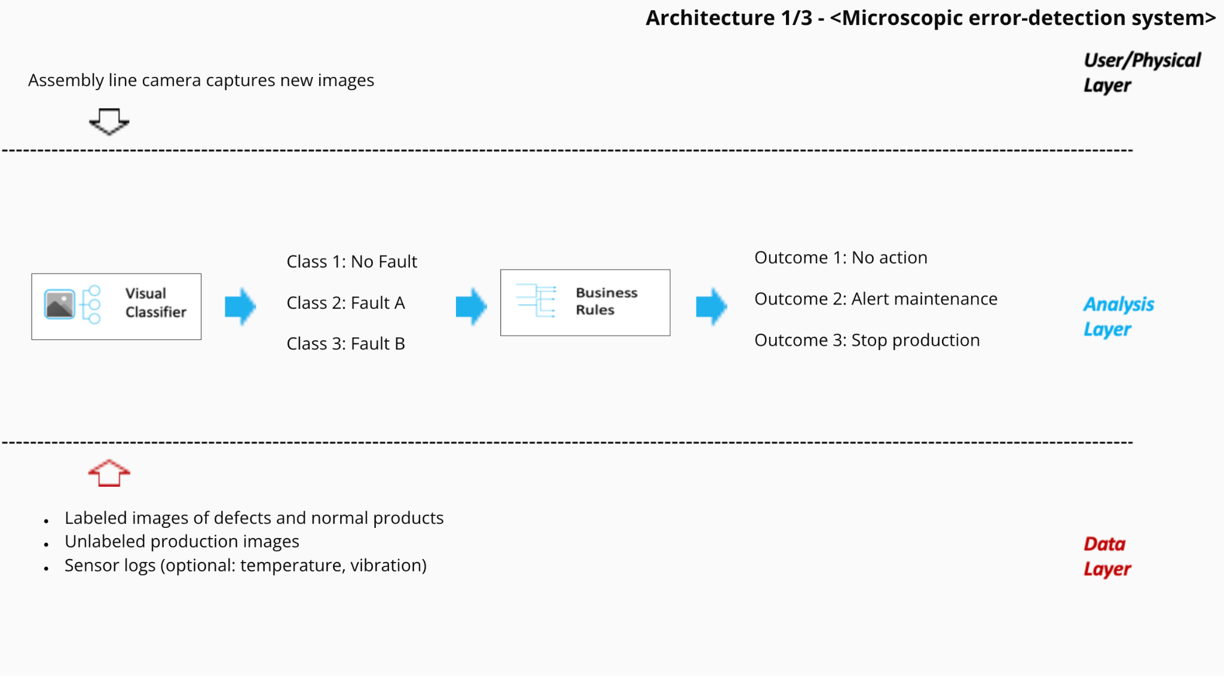
Microscopic error-detection system Deep Dive
Process Today
Mass-producing and it is difficult to reduce the error up to 0
Operation depends on the manual tasks
When the error is detected, it is fixed manually but human error can happen
Quality is maintained as much as possible but risk concerns are raised
Example Architecture
Process Tomorrow
Collect and classify a large number of product images and prepare them as training data sets
Cameras and computer vision are installed on the production line to achieve real-time automatic inspection
It instantly detects and classifies defects, and the AI even predicts causes and analyzes trends
Defect rates are reduced, minimizing the cost and risk of defects. Improved quality and reliability, resulting in a competitive advantage
The impact of quality assurance will be improved thanks to Microscopic error-detection system!

Slide 7
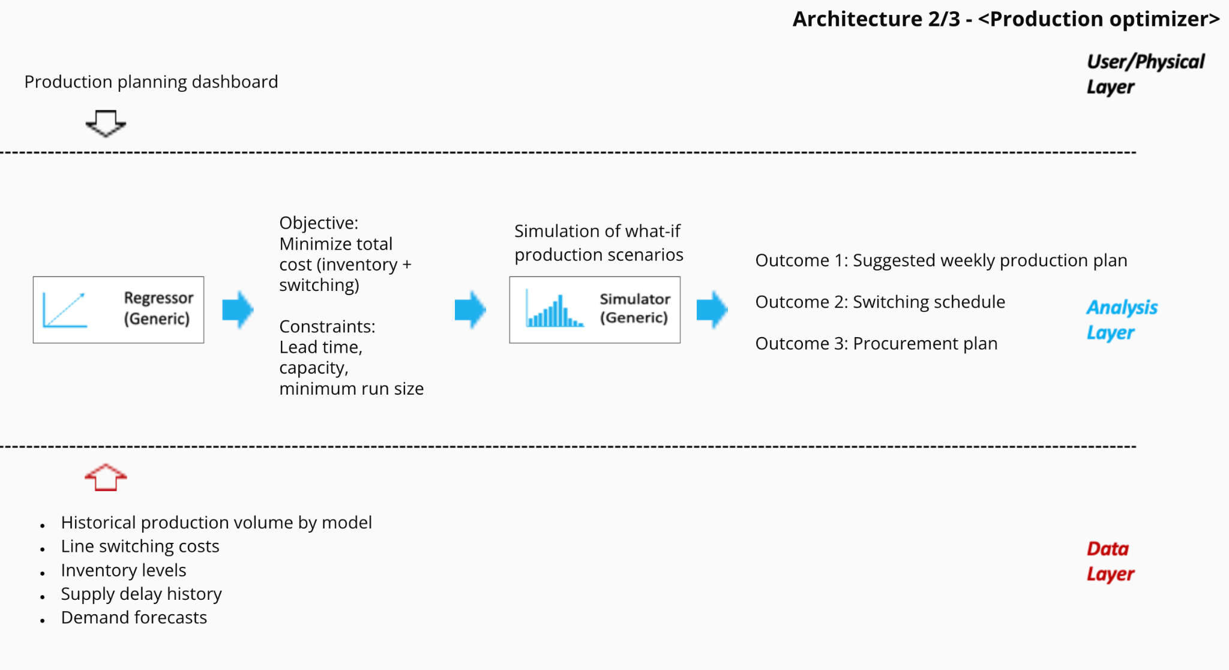
Production optimizer Deep Dive
Process Today
Multiple vehicle and battery models are manufactured at each plant, and model changeovers take significant time and cost.
Market demand and inventory status are monitored manually, and production scheduling relies on experience and intuition.
Incorrect demand forecasts lead to excess inventory and shortages, increasing switching and storage costs.
Production planning is inefficient and vulnerable to fluctuations, putting pressure on profitability. Risk of missing sales opportunities due to delayed market response.
Example Architecture
Process Tomorrow
Integrated collection and visualization of production performance, demand data, and supply chain status.
Demand forecasts and inventory trends are predicted with high accuracy using AI/ML to optimize model switching and parts supply.
A mathematical optimization model automatically calculates factory changeover, parts inventory, and manufacturing timing at minimum cost.
The company has achieved production without excesses or deficiencies, reduced inventory and changeover costs, improved on-time delivery rates, and improved cash flow health.
The impact of production planning will be improved thanks to Production optimizer!

Slide 8
Risks / Mitigations
 | Microscopic error-detection system | Production optimizer
Accuracy How correctly the model predicts or detects outcomes | Concerns: It may miss rare defects or flag too many false positives. Plan: Improve training data quality and monitor precision and recall. | Concerns: Forecasts may not reflect real market demand. Plan: Continuously update and validate forecasts with live data.
Underfitting/Overfitting Underfitting: when a model is too simple Overfitting: when it memorizes training data too closely | Concerns: A model may ignore subtle patterns or overfit to specific defect types. Plan: Use cross-validation and augment image data to balance the model. | Concerns: Models may miss demand patterns or react to noise. Plan: Tune model complexity and test on out-of-sample periods.
Ethical Concerns Risks where AI may create unfair, biased, or harmful outcomes. | Concerns: Overreliance on automation may lead to unnecessary production stops. Plan: Keep human review for critical decisions and log override frequency. | Concerns: Optimizing for profit may deprioritize smaller markets unfairly. Plan: Set fairness constraints and monitor regional service levels.

